Slide 1
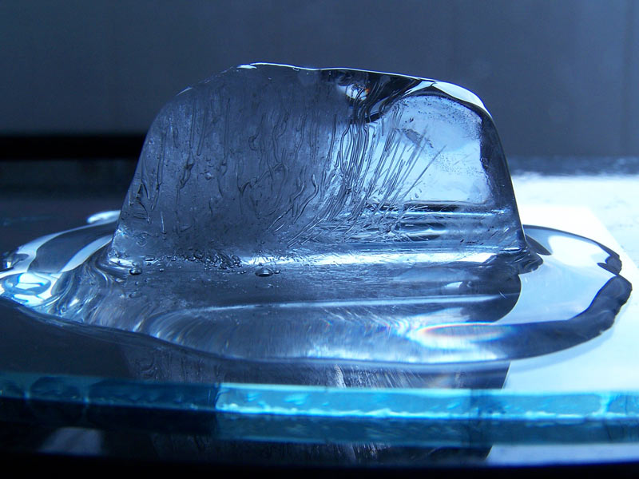
OF MATERIALS
PROPERTIES

Slide 2
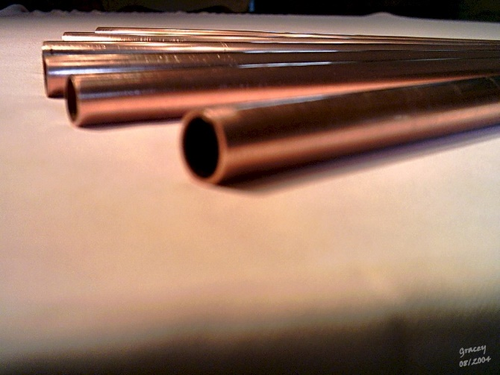
Materials
Everyday materials can be grouped together depending on some of their properties.
Typical properties of materials include:
hardness
solubility
transparency
thermal conductivity
electrical conductivity
response to magnets

Slide 3
Materials
When making something, it is very important to use the right materials for the job.
Some materials have properties which are very suitable to perform a certain job while other materials will not.
Materials may be picked for use to perform a certain job because they are strong and/or lightweight. Perhaps they are good thermal conductors or poor electrical conductors.
Watch the following clip:
Materials used to build flying machines

Slide 4
Materials
Watch the following clip:
Materials and their properties
Make a list of some of the different materials which are being used.
Make a list of some of the uses for these materials.
Can you explain some of the properties of one of the materials which you noticed?

Slide 5
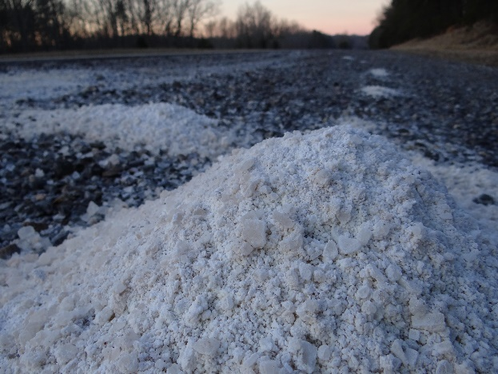
Solubility
Substances which dissolve to form a solution are said to be soluble. While substances which don’t dissolve are insoluble.
For example, both sugar and salt are soluble in water, but sand is insoluble.
Substances which are dissolved in water can be recovered again through evaporation.

Slide 6
Separating Mixtures
Mixtures of solids, liquids and gases can be separated using different equipment.
For example:
Sieving can be used to separate two solids which have different sizes of particles.
Filtering can be used to separate an insoluble solid from a liquid or solution.
Evaporation can be used to separate a soluble solid from liquid water in a solution.

Slide 7
Separating Mixtures
Decide which equipment could be used to separate the following mixtures:
Evaporating
Salt dissolved in water
Large stones and fine sand
Sieving
Filtering
Fine sand and water
Now test each of these separating methods and watch carefully how they work.

Slide 8
Using Materials
Particular materials are usually chosen to perform a particular job based on their properties.
There are usually reasons why metals are used for some jobs whereas wood or plastic are used for others.
Other completely different materials may give the best performance, such as using Gortex for swimming costumes and waterproof clothing.
Watch the following clip:
Testing different materials

Slide 9
Using Materials
Watch the following clip: materials and their uses
Which materials could you identify being used and what jobs were they being used for?
Why was the particular material being used for a certain job?

Slide 10
Decide whether metal, wood or plastic is most suitable for the following jobs...
Metal
A ship’s anchor
E.g. Plastic
Guttering for a roof
E.g. Wood
Garden bench
Can you explain why you chose the particular material to do the job? (there maybe more than one option!)
Can you explain why one of the other materials couldn’t do that particular job?

Slide 11
Reversible Changes
Some types of changes which can be undone are known as reversible changes.
This means they can be changed from one form into another and then back into their original form.
All of the following are reversible changes:
Melting
Freezing
Evaporating
Condensing
Dissolving

Slide 12
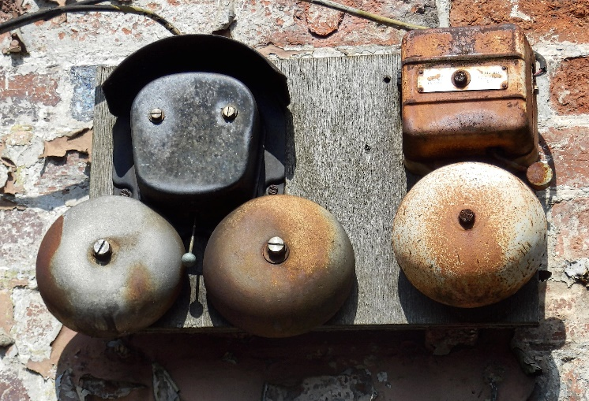
Irreversible Changes
Some types of changes can’t be undone which are known as irreversible changes.
This means once the new products during a reaction have been formed they can’t change back into their original form.
All of the following are irreversible changes:
Burning
Rusting
Reacting a metal and acid

